Slide 1
Investigation of crime by county in California
Ryan Bandrowski
Tyler Ratajczyk
Kyle Moretti

Slide 2
Purpose
All Data were obtained for each of the 58 counties in California
Research questions:
1. Is there a relationship between population density and crime rate?
Does this relationship differ depending on the type of crime?
2. Is there a relationship between number of police officers and crime rate?
Does this relationship differ depending on the type of crime?

Slide 3
Data Process
Data sources
Data Clean-up process
Notes:
Where did these data come from? What sources?
How was the data cleaned? What steps were used? Was there missing data? How many files were merged?

Slide 4
Data Analysis
Data Analysis consisted of exploratory plots that examined the strength of the relationships
Notes:
Was anything other than the plots done? I only can see the plots in Ryan’s shared github folder

Slide 5
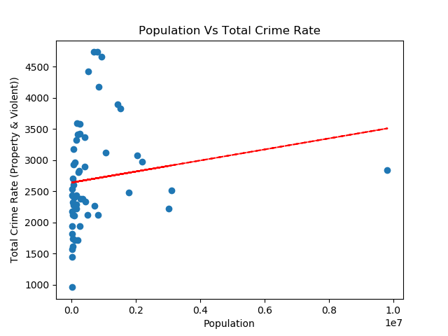
Figure 1: Total Crime by Population

Slide 6
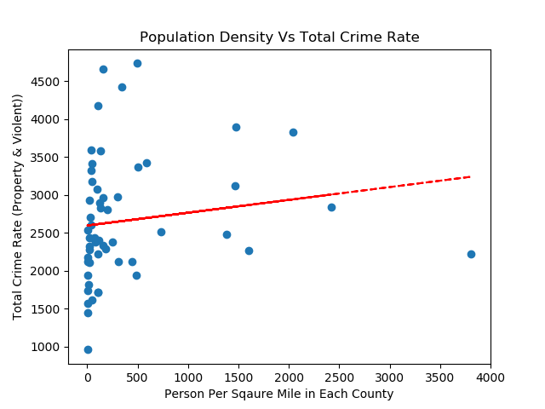
Figure 2: Total Crime by Population Density

Slide 7
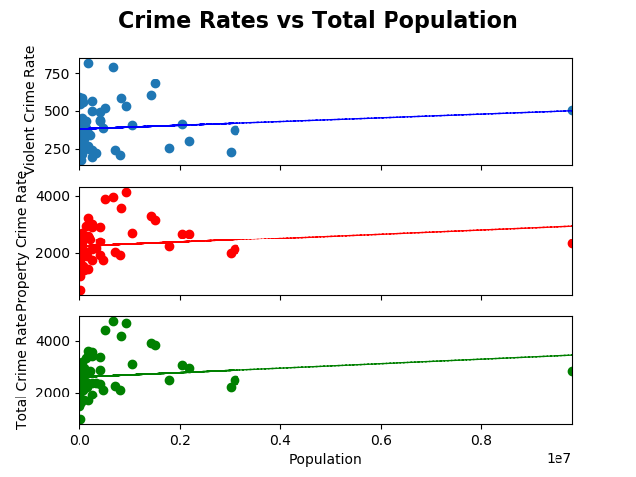
Figure 3: Type of Crime by Population

Slide 8
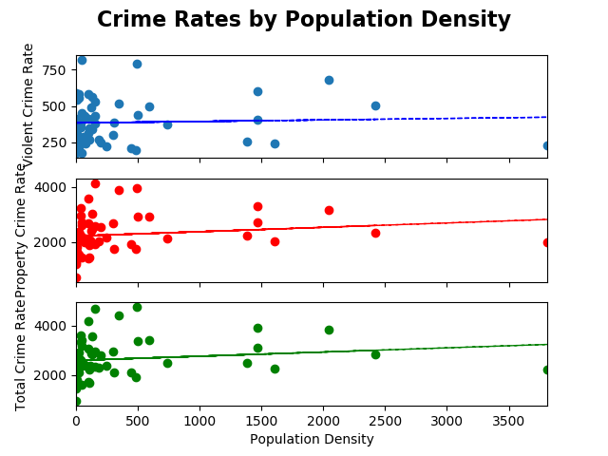
Figure 4: Type of Crime by Population Density

Slide 9
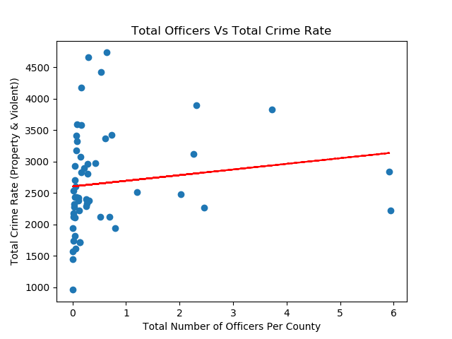
Figure 5: Total Crime by Total Officers
Notes:
What are these units?

Slide 10
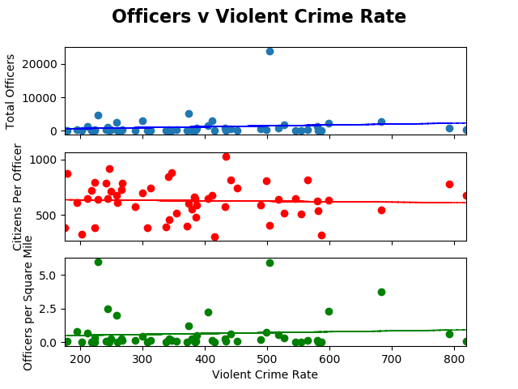
Figure 6: Officers by Violent Crime Rate
Notes:
What are these units?

Slide 11
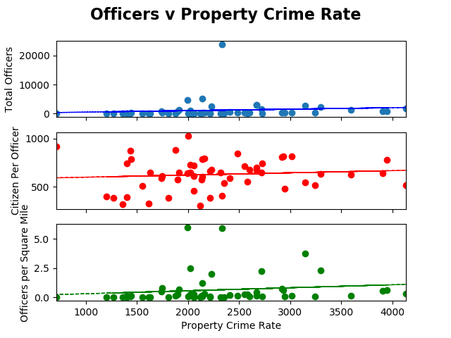
Figure 7: Officers by Property Crime Rate
Notes:
What are these units?

Slide 12
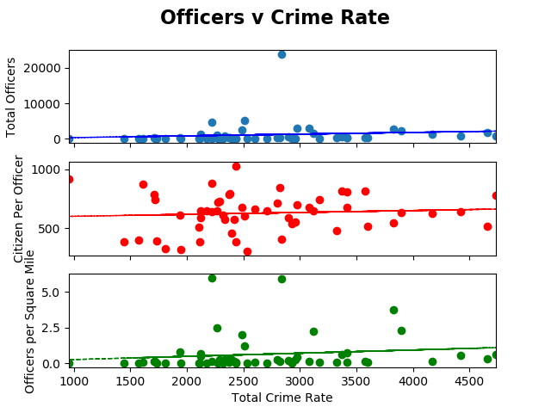
Figure 8: Officers by Total Crime Rate
Notes:
What are these units?

Slide 13
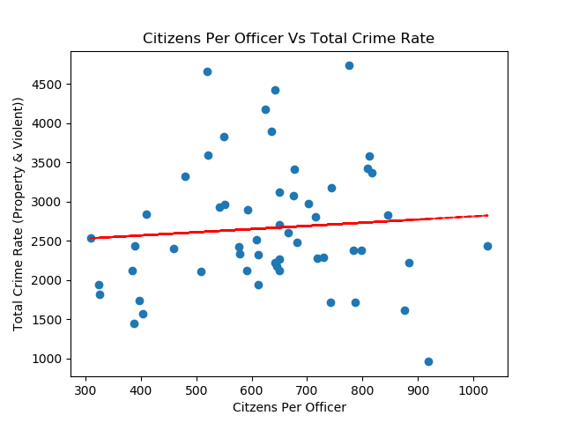
Figure 9: Citizens per Officer by Total Crime
Notes:
What are these units?

Slide 14
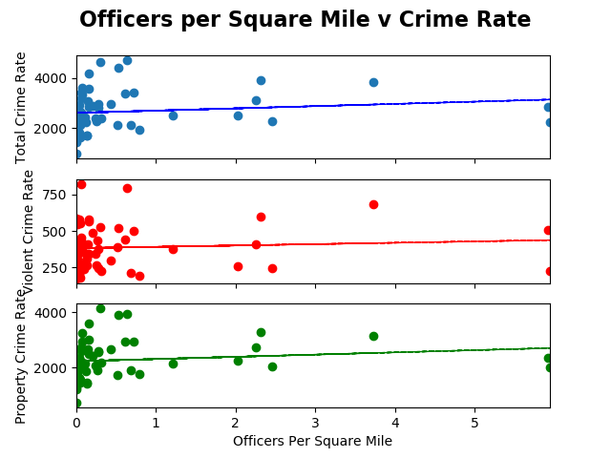
Figure 10: Crime Rate by Officers per Sq.Mile
Notes:
What are these units?

